Slide 1
Whipping your large site into shape!

Slide 2
Read.me
Lead Developer Evangelist for HERE Technologies (developer.here.com)
Co-author of The Jamstack Book (MEAP access at Manning!)
https://www.manning.com/books/the-jamstack-book
raymondcamden.com
@raymondcamden (DMs are open!)

Slide 3



HISTORY LESSON
Photo by Dario Veronesi on Unsplash

Slide 4
Raymondcamden.com
Launched my blog in February of 2003
6148 entries, 341 a year
Custom blog-ware using Adobe ColdFusion and SQL Server
Roughly 100K pageviews per month
Notes:
2007, 825
Twitter slowed me down, 65 last year, on track for about 85 this year

Slide 5

Changes…
Switched to WordPress in December 2014
And it went perfectly!
Notes:
Omg no it didn’t.
Lots of crashes, not optimized out of the box
WP is a beautiful engine. But crashy as hell

Slide 6
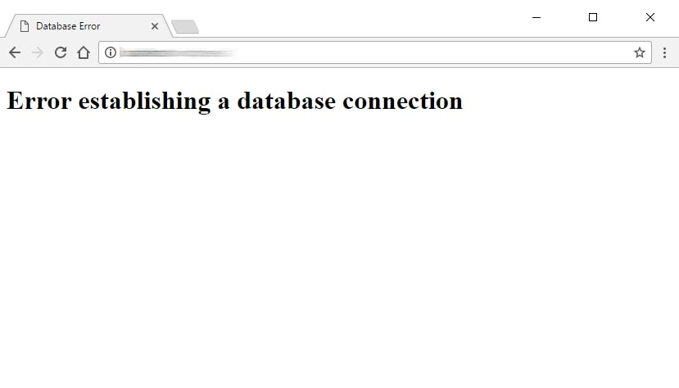

Slide 7

More changes…
Moved to Hugo in January of 2016
Fast!
But I hated Hugo.

Slide 8
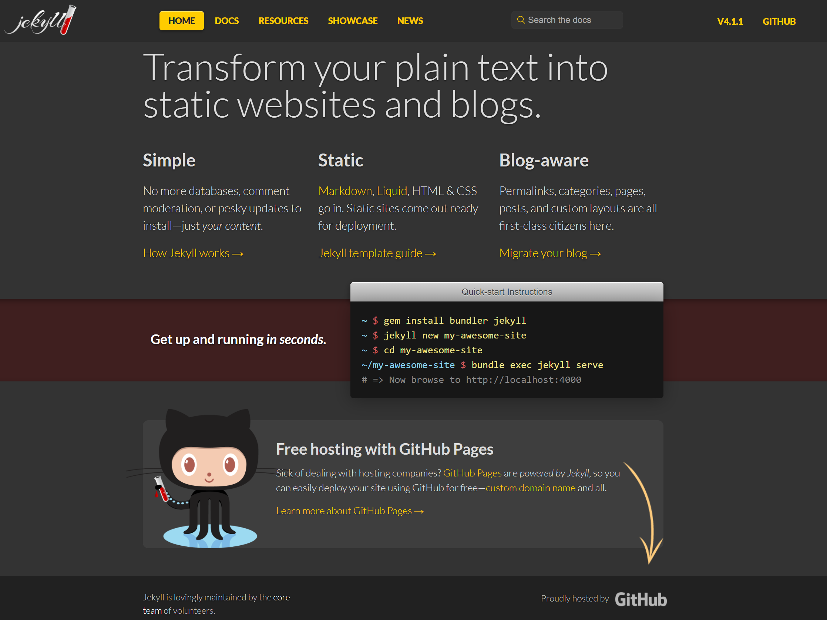
Even More changes
Moved to Jekyll in May of 2018
Not as fast
But I liked it!
But I hated installing it on Windows. ☹

Slide 9
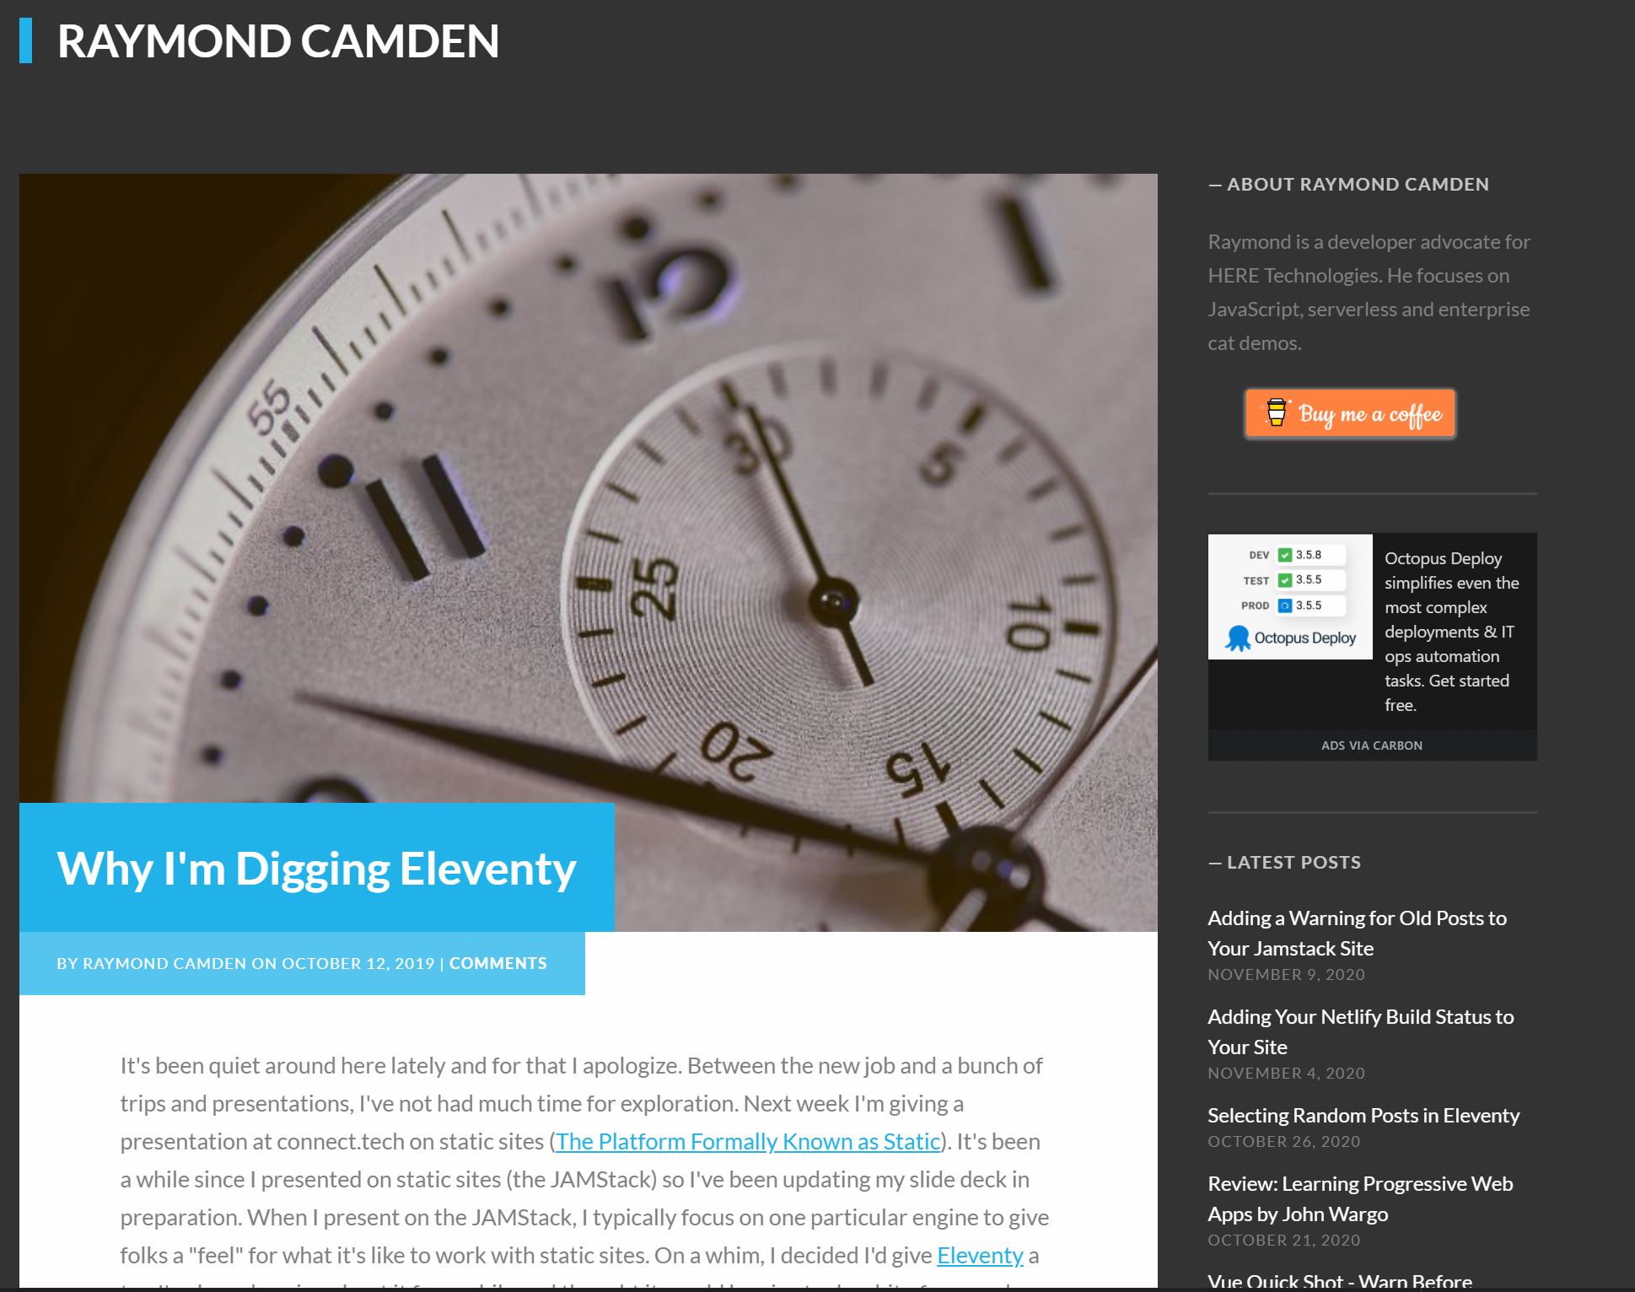

Slide 10

Yet another change…
Discovered Eleventy in October of 2019

Slide 11
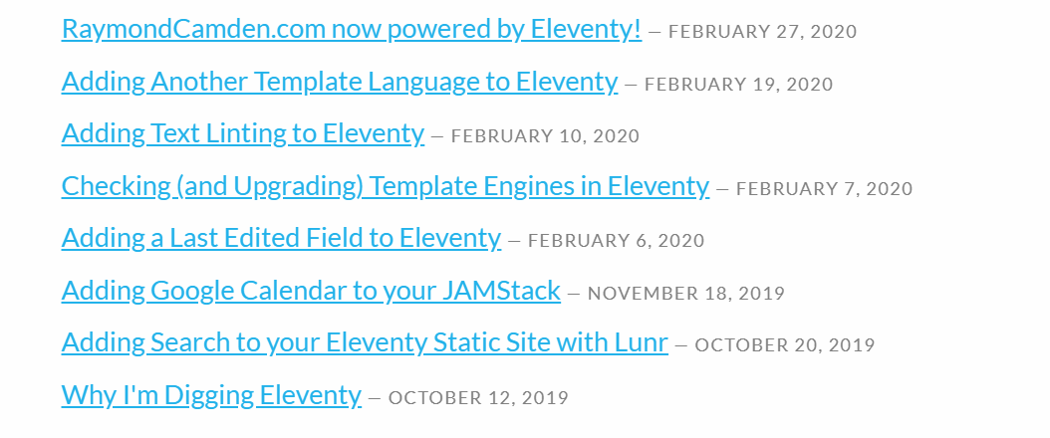

Slide 12
Managing a large Site is hard
Making local development better
Making build times better
Handling media

Slide 13
Local Dev ideas
Use --quiet
Notes:
All this does is suppress output

Slide 14

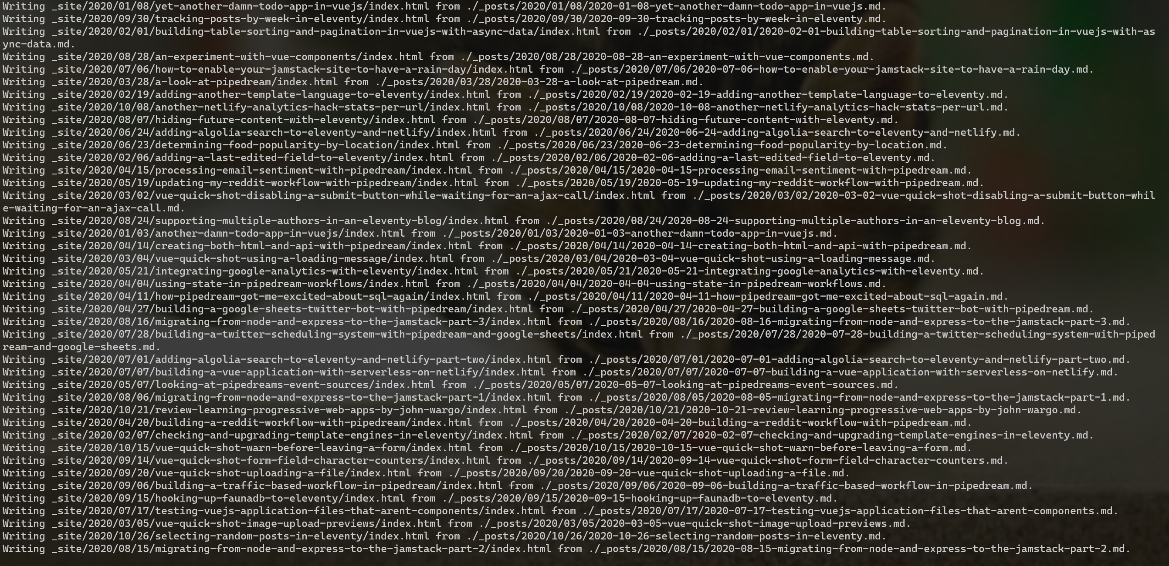

Slide 15
Local Dev ideas
Use –quiet
Use .eleventyignore
Notes:
New line separated list of files (or globs)
.gitignore is also checked, can be disabled
Node_modules also ignored

Slide 16
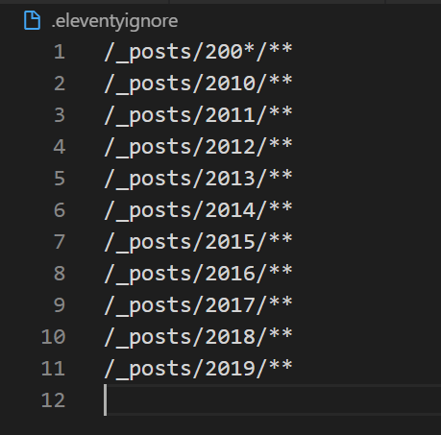

Slide 17
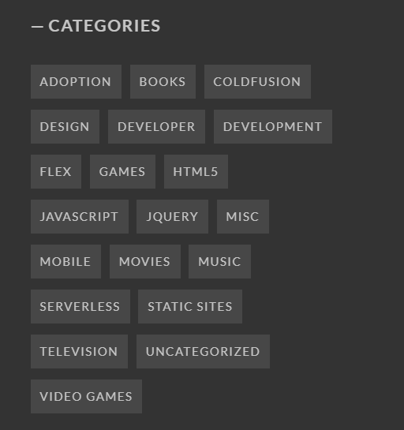
.eleventyIgnore Caveats
Don’t check it into your repo
Currently no way to configure the ignore file
UI issues
Notes:
Jekyll did this better
UI issues – just testing things

Slide 18
Local Dev ideas
Use –quiet
Use .eleventyignore
Look for startup stuff you can mock
JavaScript logic in your _data
Notes:
New line separated list of files (or globs)
.gitignore is also checked, can be disabled
Node_modules also ignored

Slide 19
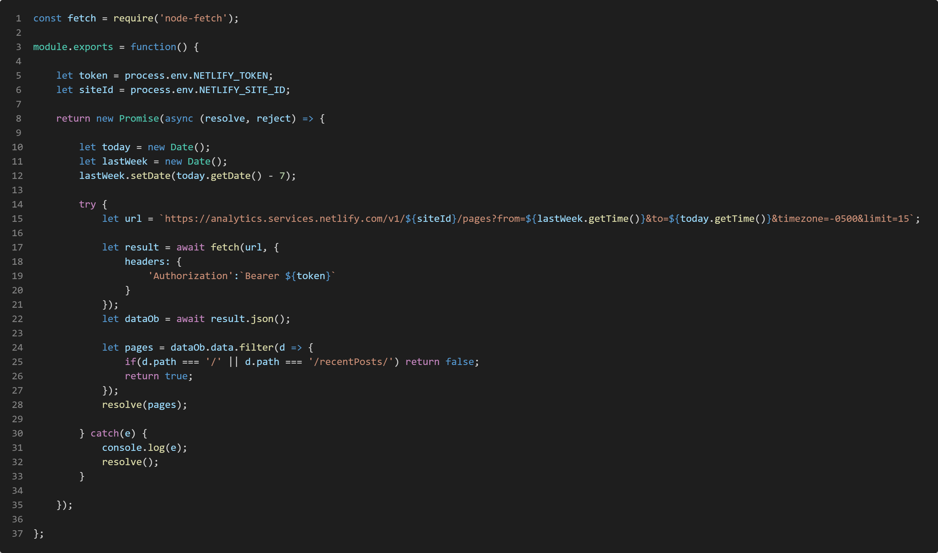

Slide 20
Production Ideas
Diagnose and track what impacts the entire site
Netlify specific: Disable form processing (if not using it, duh ;)

Slide 21
Partial vs Full Site Updates
Some changes impact one page
Some impact everything
Notes:
On one hand, obvious what impacts everything, if I change my theme, if I change my footer
Somethings not obvious

Slide 22
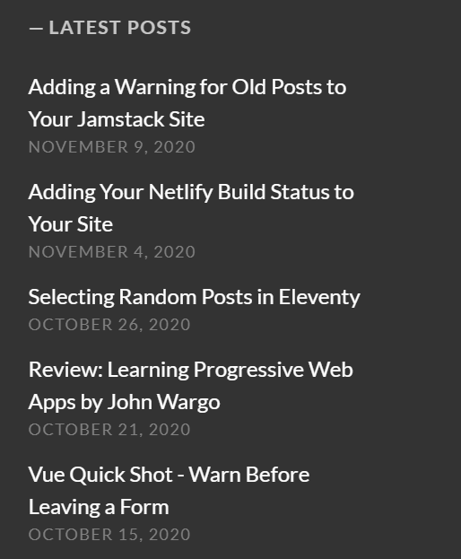
Notes:
My solution – use Ajax
Why I left Hugo

Slide 23
Form processing
Netlify specific
Disables looking for forms to support

Slide 24
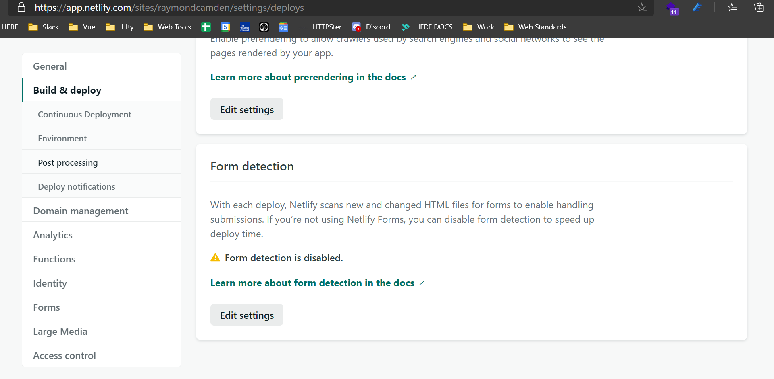

Slide 25
Media
1K images
50 zip files
Other “stuff”

Slide 26
Media – My solution?
Amazon S3
Visual Studio Code snippet for images
“Mostly” easy (https was a pain)

Slide 27
So how’s it working for ya?

Slide 28
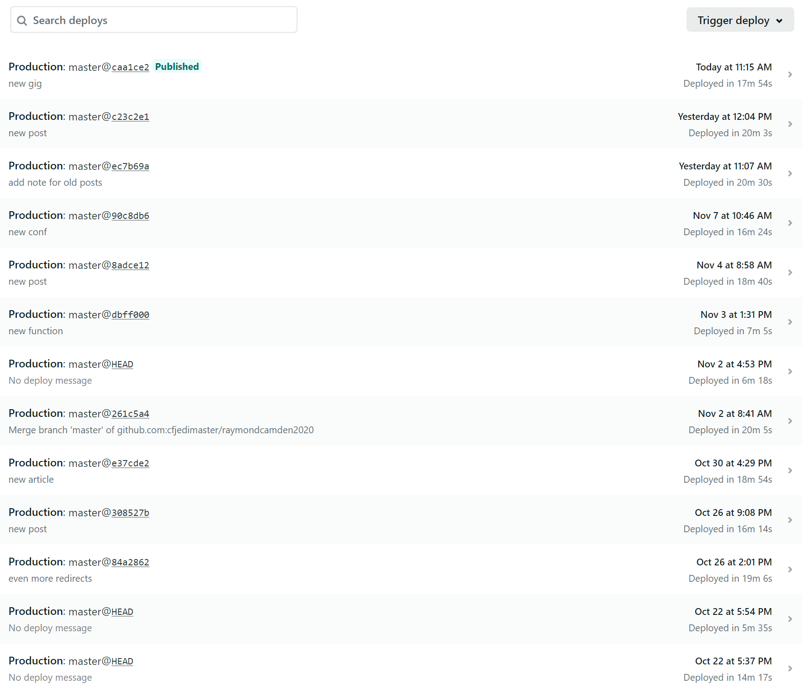

Slide 29

THANK YOU!

